Slide 1
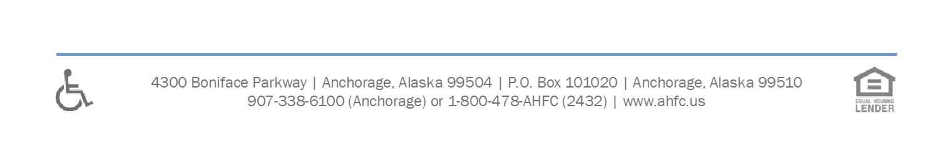
Alaska Housing Stabilization and Housing Recovery Program
Enki Workflow
May 27, 2022

Slide 2
Training Objective
When to enter clients into Enki
How to enter clients
When to modify records and the appropriate selections to use.

Slide 3
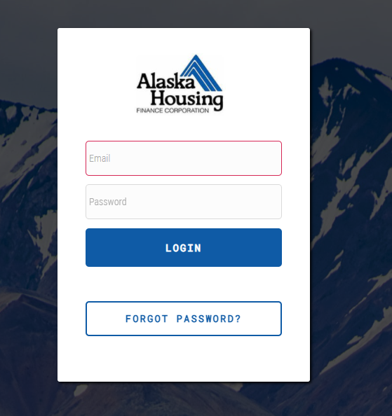
Getting Started
Login to Enki at https://enki.alaskahousingrelief.org/home_index

Slide 4
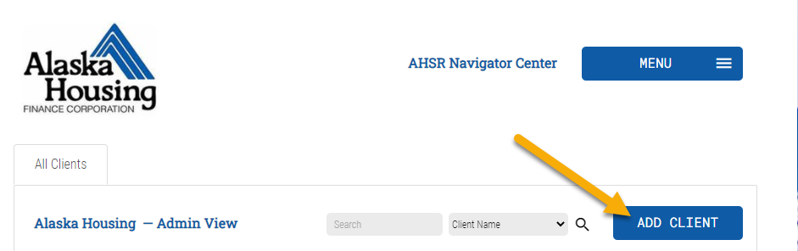
Data Entry – Adding Clients
Once you have identified a client and moved them into temporary stabilized housing you must enter their client record.
Important Note: Once a client record is entered, their months of assistance clock starts. So it is important not to enter them into the system until you are ready to actively stabilize them.

Slide 5
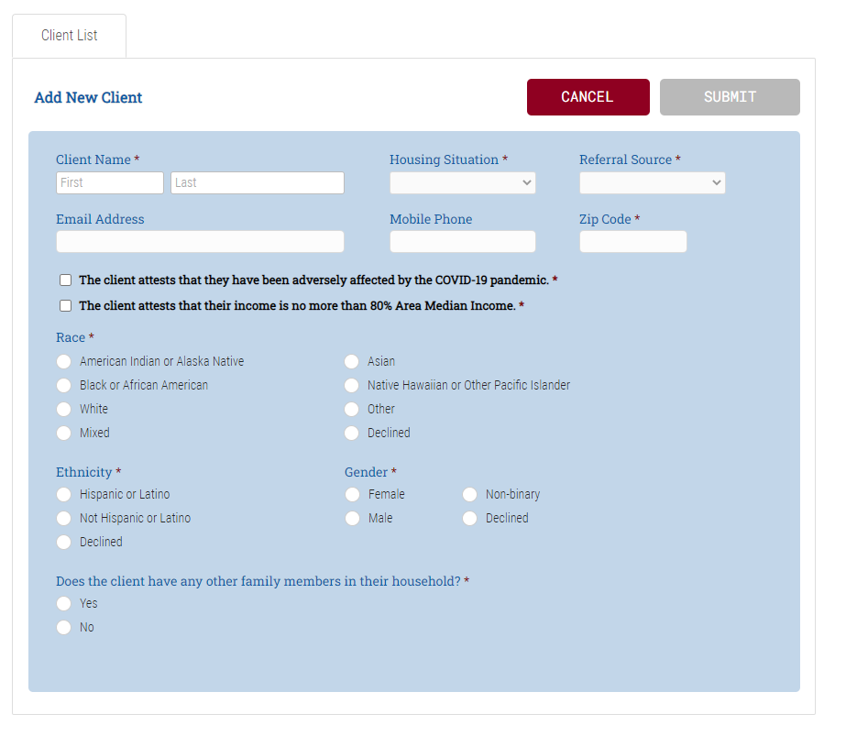
Data Entry – Adding Clients
Enter all relevant personal data. Anything with a * is required.
Housing Situation: Where was the applicant sleeping?
Referral Source: How did you find the client?
Annual Income: Collect from the client in the form of verbal attestation.
Household Family Members: List the number of any other household members, and children under the age of 18

Slide 6
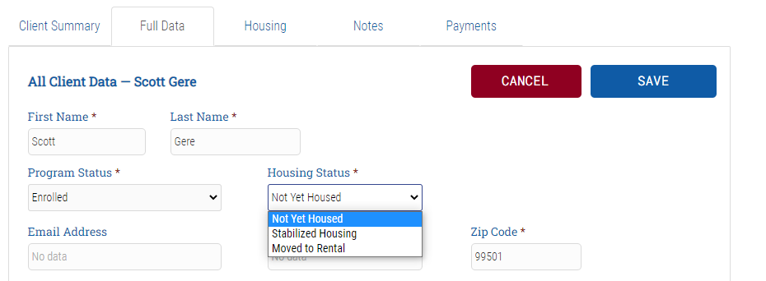
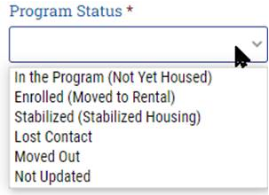
Data Entry – Full Data tab
Update the Program Status
  In the Program (Not Yet Housed) - you have not yet moved the client into any kind of housing. Be advised: a client with this status should not remain here for long, as their assistance clock has started.
  Enrolled (Moved to Rental) - your client has secured Long Term Housing. This also means that they are now enrolled in the Rent Relief Program. Housing status should also be updated to “Moved to Rental.”
  Stabilized (Stabilized Housing) - you have moved them into temporary housing such as a hotel or motel. Housing Status should also be updated to “Stabilized Housing.”
  Lost Contact – you have lost contact with the client.
  Moved Out – Use this status if your client has exited the program
  Not Updated – please update all clients on a weekly basis.

Slide 7
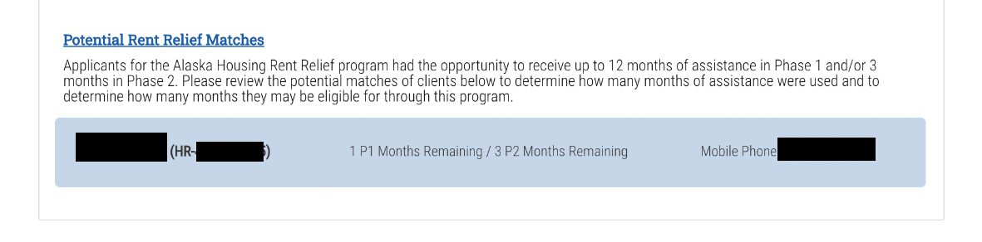
Data Entry – Housing tab
Did your client previously receive rent relief assistance?
Potential matches will be displayed on the housing tab
  Potential matches show how many months of assistance were received
  A mobile phone number is also provided as an additional reference point to confirm whether the potential match is your client
  If you are still unsure if a potential match is your client, please reach out to stabilization@ahfc.us. Additional cross reference tests can be performed.

Slide 8
Data Entry – Housing tab
Once the number of months used for rent relief is confirmed, review the Global Policies & Procedures to determine how many months your client is eligible for.
In this example:
  Client has used 11 months in Phase 1 and 0 months in Phase 2 of the rent relief program.

Slide 9
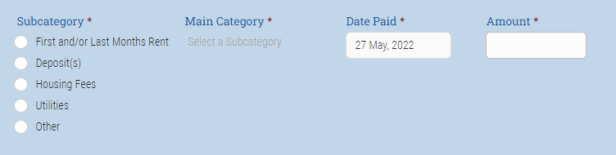
Data Entry – Payments tab
Add a Payment
  Payment Category:
    First and/or Last Months Rent: This is if first and/or last months’ rent is required to secure a unit.
    Deposit(s): This encompasses any security deposits or utility deposits necessary to secure a unit.
    Housing Fees: Any application or background check fees
    Utilities: This encompasses any utility payments that may be necessary for the client.
    Other Stability Services: this is a catch all for other services that may be required to get the client stabilized

Slide 10
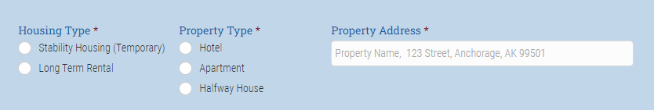
Data Entry – Payments tab
  Housing Type:
    Select appropriate type and enter address. The address will then update on the Housing Tab.

Slide 11
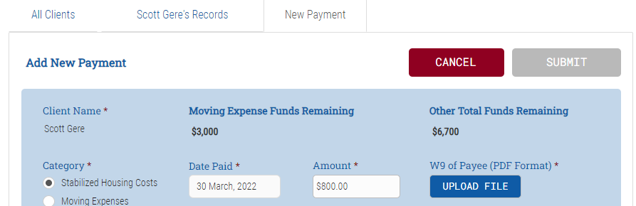
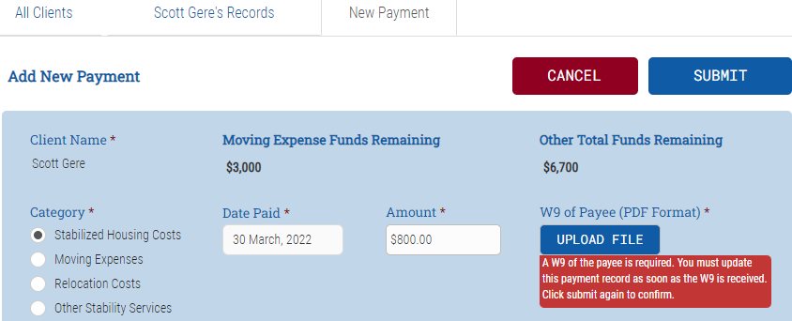
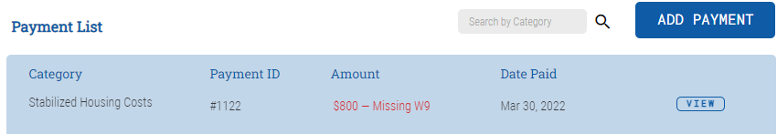
Data Entry – Payments tab – W9
W9 Requirements
  All payments over $600.00 will require a W9 to be uploaded with the payment information.
  If you do not have a W9 at the time of entering payment information you may still enter the payment by clicking “Submit” two time.
  The first click on “Submit” will bring up a red text back letting you know a W9 is required for payment.
  The second click on “Submit” will post the payment to the “Payment List” in red font letting you know the payment is missing a W9

Slide 12
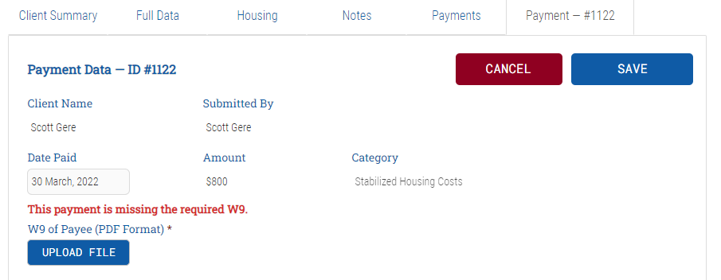
Data Entry – Payments tab – W9
W9 Upload
  To upload a missing W9 find the payment that is missing the W9 and click “View” then click “Update Data”
  You will now be able to upload missing W9 for payment.
  Once finished please make sure to click “Save”

Slide 13
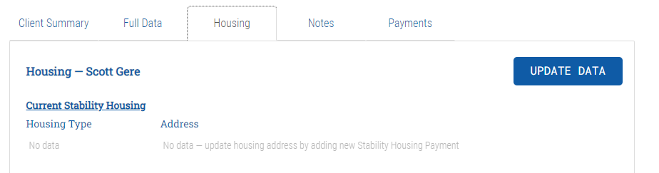
Data Entry – Housing tab
Once a payment is added, the client’s housing type and address will be updated.
When your client is ready to start looking for long term housing:
  Enter the date you Began Shopping for a rental.
  When a unit is found, enter the date the client Entered Housing

Slide 14
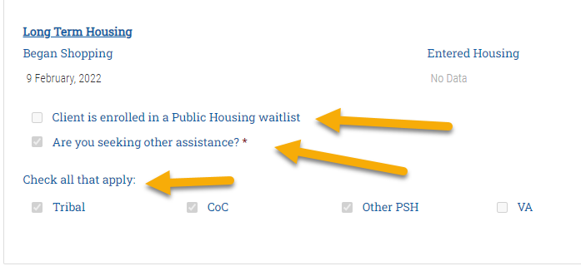
Data Entry – Housing tab (cont.)
Be sure to update the housing tab when you have assisted the client with enrolling in Public Housing or another form of assistance.

Slide 15
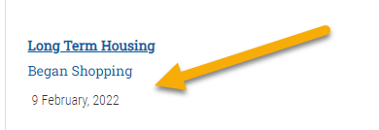
Data Entry – Housing tab
When your client is ready to start looking for long term housing:
  Enter the date you Began Shopping for a rental.

Slide 16
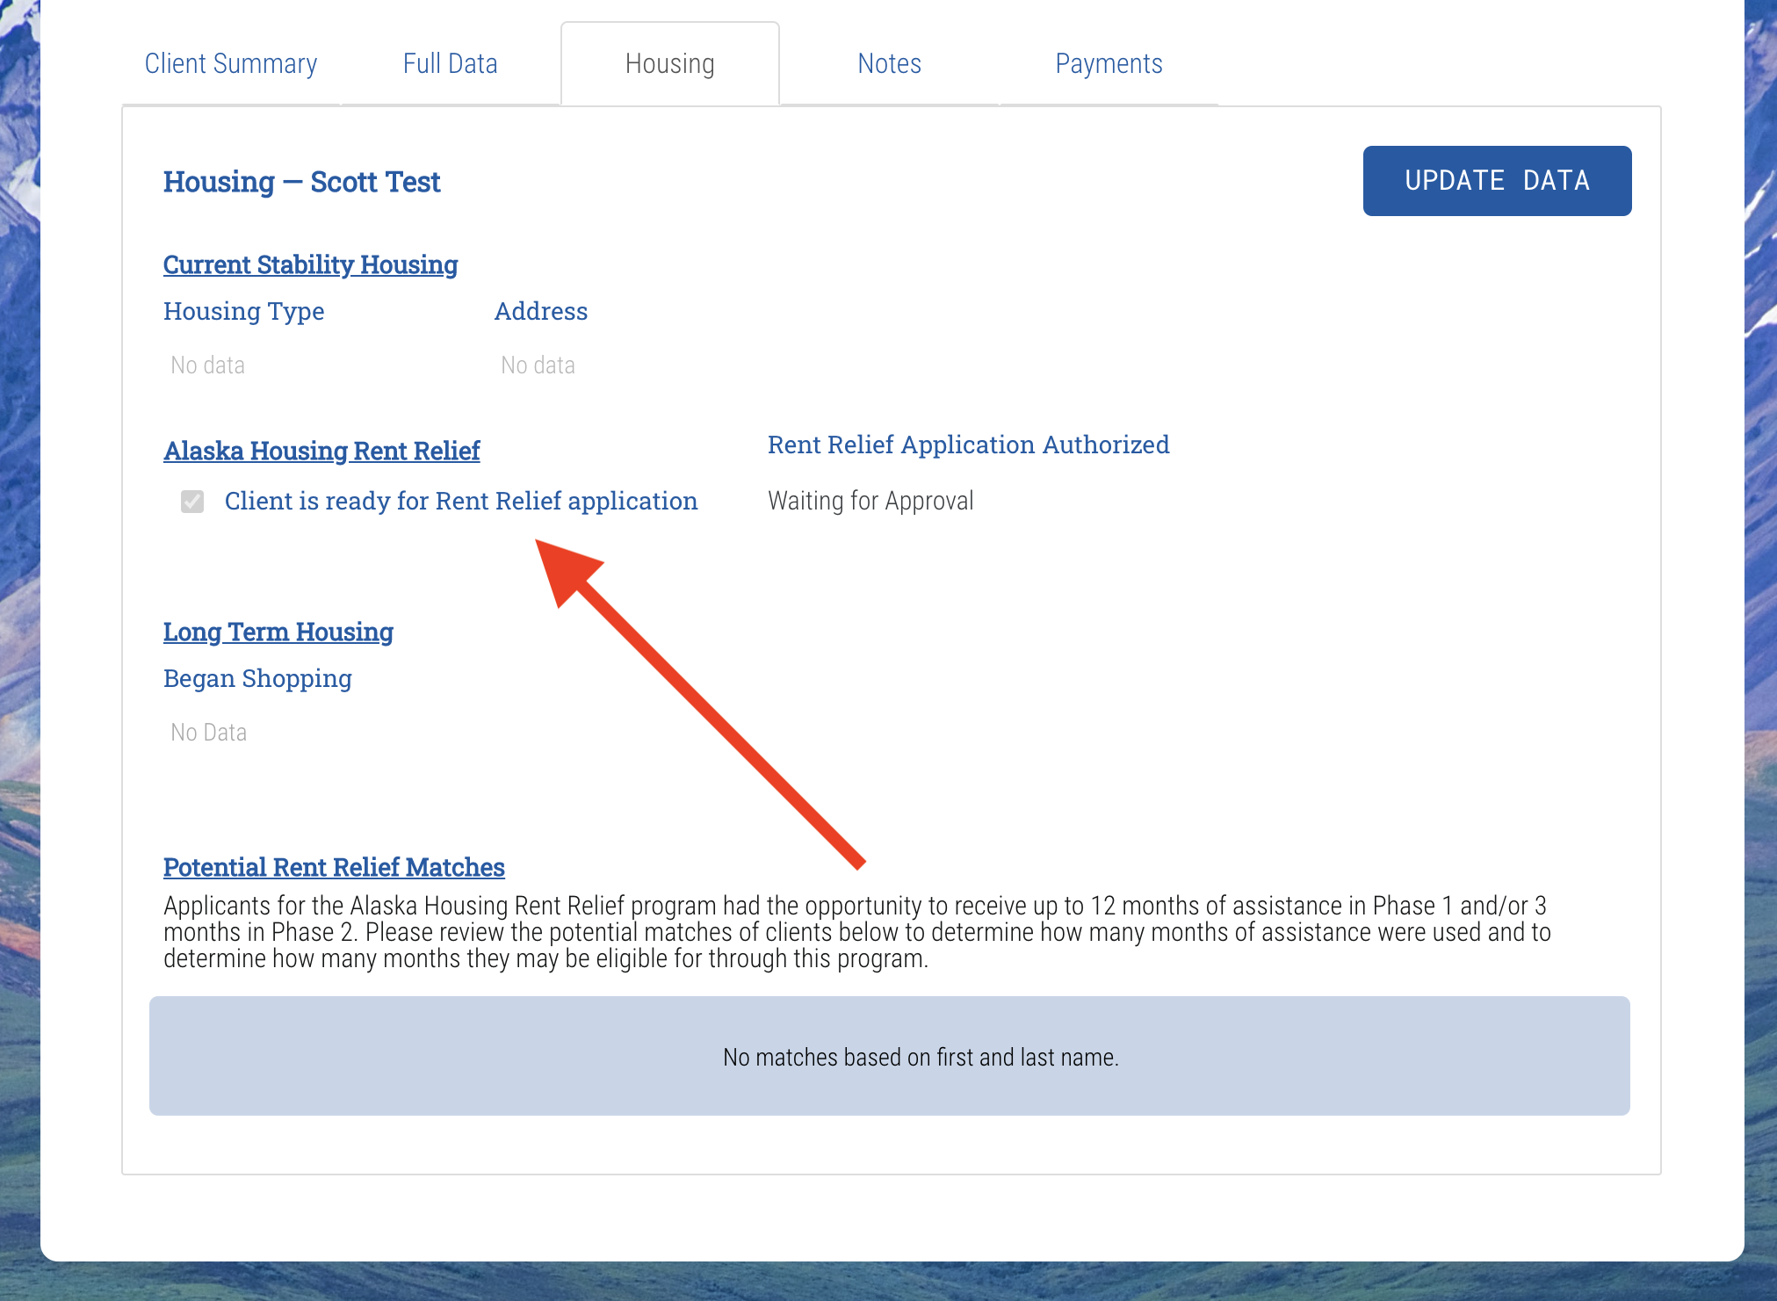
Enrolling in Rent Relief
Once the client is ready for rent relief, check the box on the Housing Tab.
  You no longer need to email a list of your clients who are ready for rent relief to AHFC.

Slide 17
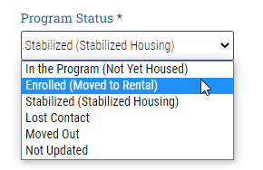

Enrolling in Rent Relief (cont.)
Once you have checked the box that your client is ready for rent relief, be sure to update the program status and the lease information on the Full Data tab.

Slide 18
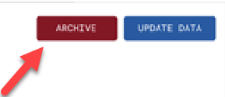

Exiting Client in Enki
Once the client is ready to exit the program, enter the date the client exited. Team Leads have the option to archive the client record once the exit date has been entered, by selecting the “Archive” button.

Slide 19


For additional resources, visit: https://www.alaskahousingrelief.org/resources/housing-stabilization

